Slide 1
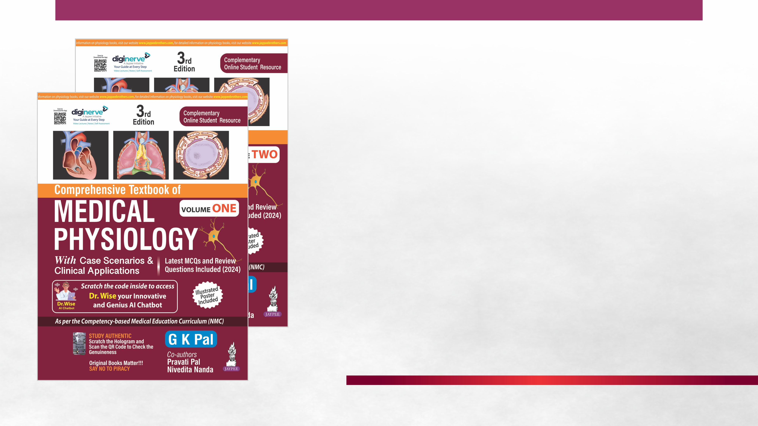
Chapter 73
Physiological Changes at High Altitude

Slide 2
Learning Objectives
The student will be able to: (MUST KNOW)
1. Say at which altitude significant hypoxia occurs, and the maximum height up to which adaptation occurs.
2. Give the mechanisms of ventilatory adaptation at high altitude.
3. List the respiratory, cardiovascular, hematological and tissue changes at high altitude.
4. Name the high-altitude illnesses and give their physiological basis of treatment.
The student may also be able to: (DESIRABLE TO KNOW)
1. Describe the physiological changes at high altitude.

Slide 3
INTRODUCTION
It is important to note that the percentage of oxygen does not alter at high altitude rather the barometric pressure decreases. Therefore, the responses at high altitude are due to decreased tension of oxygen (P_{I}O₂) in inspired gas.
Hypoxic symptoms appear at 10, 000 feet and become severe at15000 to 18000 feet.
Above 20000 feet, barometric pressure is around 50% of the normal value. However, normally the effects are not severe when the ascent is slow while camping at different heights.
Compensatory mechanisms develop to adopt to higher altitudes, if the ascension is gradual, in phases with temporary stationing at different heights.Otherwise, acute mountain sickness develops.

Slide 4
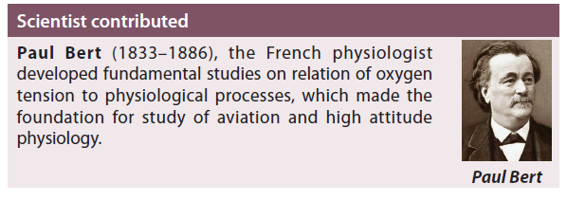


Slide 5
COMPENSATORY MECHNISMS
At high altitude, decrease in P_{I}O₂ decreases oxygen supply to the tissues. To deliver normal quantity of oxygen to the tissues, many compensatory mechanisms are activated.
Immediate and important amongst them is hyperventilation. Hyperventilation induced by hypoxia is not significantly prominent unless alveolar PO₂ decreases below 60 mm Hg.
Normally drop in alveolar PO₂ to 60 mm Hg occurs at an altitude of approximately 4500 m (14000 feet).

Slide 6
Stages of Compensation
HYPERVENTILATION: The hyperventilation induced by hypoxia at high altitude appears in two stages:
In First Stage
In the first stage that appears immediately on exposure to hypoxia ventilation increases instantly though the increase in ventilation is small compared to the increase in ventilation in the second stage.
The hyperventilation in first stage is mainly due to hypoxic stimulation of the carotid bodies.
The magnitude of increase in ventilation is less because the hypoxic stimulation of peripheral chemoreceptor is opposed by the decrease in arterial PCO₂that occurs due to excess removal of carbon dioxide induced by hyperventilation.
Decreased arterial PCO₂ and alkalosis together blunt the hypoxic response.

Slide 7
In Second Stage
In second stage, ventilation increases slowly in 8 to 10 hours and then remains sustained.
The sustained increase in ventilation is due to the ventilatory acclimatization at high altitude. Ventilatory acclimatization is a physiological response that occurs during prolonged exposure to hypoxia.
After about 2 weeks, hyperventilation induced by hypoxia reaches a stable plateau.
MECHANISMS: There are two mechanisms for ventilatory acclimatization.
Chemoreceptor mechanism: The pH of CSF is more alkaline in the acute phase.
However, ventilation stimulated by hypoxia brings pH close to normal by the movement of bicarbonate out of the CSF.
In prolonged exposure to hypoxia, sensitivity of carotid body to arterial PO₂ also alters.

Slide 8
2. Renal mechanism: The alkaline blood pH that occurs due to hypoxia-induced hyperventilation opposes the hypoxic response that decreases ventilation.
However, kidney compensates pH by excreting more bicarbonate. This decreases blood pH towards normal in about 3 days. Thus, the effects due to alkaline pH are minimized.
This allows hypoxic drive to further increase minute ventilation and then attain a steady state.

Slide 9
Acclimatization at High Altitude
When a person ascends to high altitude and stays there for longer periods, he slowly gets adapted to the new environment. This process of adaptation is called acclimatization.
The acclimatization at high altitude starts within twelve hours and may take several days or weeks to complete.
The maximum height upto which adaptation occurs is 18000 feet. Beyond this level, the subject needs O₂ inhalation for survival.
Adaptive changes mainly occur inrespiratory system, cardiovascular systems, blood and tissues.
The primary objective of these changes is to increase oxygen supply to the tissues.

Slide 10
Respiratory Changes
Hypoxia stimulates peripheral chemoreceptors.
1. This increases pulmonary ventilation by increasing rate and depth of respiration.
2. Consequently, CO₂ is washed off and alkalosis develops (respiratory alkalosis). Alkalosis counteracts stimulating effects of hypoxia.
3. The kidney corrects blood pH by excreting HCO₃^{ˉ}in urine.
  Thus, urine becomes alkaline.
  This helps the response of the respiratory center to hypoxia to continue so that pulmonary ventilation is maintained at higher levels.

Slide 11
4. Ventilation also steadily increases due to active transport of H⁺ into the CSF. Though ventilatory response decreases slowly after four days, it remains permanently above the pre-exposure level.
5. After about 4 days of acclimatization, ventilatory response slowly increases, which also depends on the level of altitude.
  As the altitude increases, magnitude of response increases.
  Ventilatory equivalent (VE) increases with increase in height of altitude (Fig. 73.1). VE is a better index of ventilatory response. VE is the ratio of expired minute volume (V_{E}) to the O₂ consumption (VO₂).
6. Diffusion capacity for O₂ and MVV are more in permanent high-altitude residents.

Slide 12
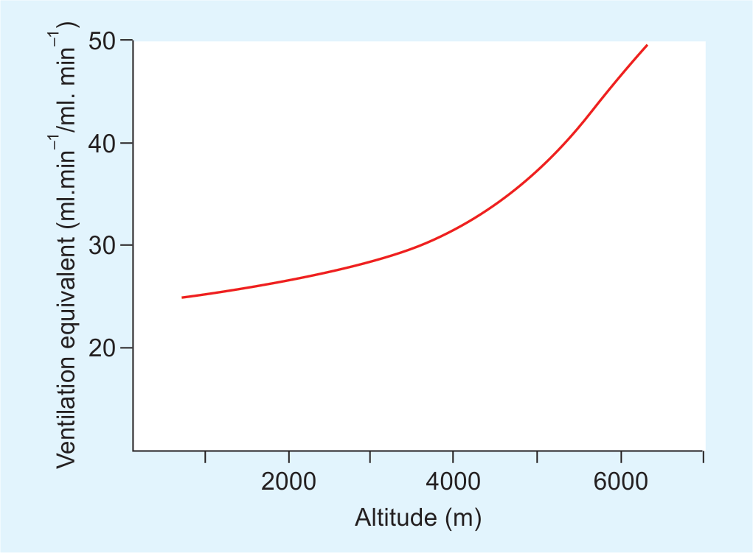
Effect of altitude on ventilatory equivalent (VE).

Slide 13
Hematological Changes
The hematological changes that improve oxygen supply to tissues include increased red cell production and improved oxygen transport.
1. Hypoxia stimulates production of erythropoietin (Ep).
  Ep-induced erythropoiesis starts in about three days and continues till the person remains at high altitude.
  Increased red cell mass facilitates oxygen delivery to the tissues.
2. Oxygen supply to tissues is also favored by increased concentration of 2,3-DPG in the red cells.
  Increased 2,3-DPG shifts oxyhemoglobin dissociation curve to the right (though initially oxyhemoglobin dissociation curve to the left due to alkalosis), which favours release of oxygen from Hb in the tissues.

Slide 14
Cardiovascular Changes
In the early phase, heart rate, cardiac output and blood pressure increase.
These changes occur due to activation of sympathoadrenal axis by hypoxia.
Gradually, heart rate returns to normal. However, some people may continue to have high blood pressure. Increased cardiac output helps to increase blood flow.
Hypoxia causes vasodilation in the systemic circulation that adds to increase in blood flow and oxygen supply to the tissues.
Though increased red cell mass improves oxygenation of tissue, significant polycythemia(increased hematocrit) increases viscosity of blood, which in turn increases the workload on the heart. This leads to cardiac hypertrophy.

Slide 15
Tissue Changes
Following tissue changes occur, especially in the skeletal muscles:
Increase in number of capillaries.
Increase in the number of mitochondria in the cells.
Increase in activity of oxidative enzymes like cytochrome oxidase.
Increase in myoglobin content.
Angiogenesisoccurs due to release of chemicals from the hypoxic tissue that stimulate formation of new blood vessels.

Slide 16
HIGH ALTITUDE ILLNESS
Types of Illness
High altitude illness includes acute mountain sickness, chronic mountain sickness, high altitude cerebral edema, and high altitude pulmonary hypertension and edema.
Acute Mountain Sickness
Sudden exposure to high altitude leads to development of certain signs and symptoms that are together referred to as “Acute Mountain Sickness”.
  Usually, people develop fatigue, dyspnea, nausea, vomiting, diarrhea, headache, insomnia and palpitations. Loss of co-ordination, memory and judgment are not uncommon. Euphoria and emotional changes are also observed.

Slide 17
  These symptoms appear within 4 to 8 hours of arrival at high altitude and may last for several days.
  In severe hypoxia or in susceptible individuals, pulmonary and pulmonary cerebral edema develop.
Chronic Mountain Sickness (Monge’s Disease)
This is seen in long-term exposure to high altitude.
These people develop malaise, fatigue, hypervolemia, exercise intolerance and polycythemia.
Pulmonary hypertension, right ventricular hypertrophy and heart failureare quite common.
All these features are collectively referred to as chronic mountain sickness

Slide 18
Pulmonary Hypertension & Edema
Pulmonary hypertension occurs due to prolonged exposure to hypoxia.
Alveolar hypoxia causes pulmonary vasoconstriction.
In chronic hypoxia, smooth muscles in pulmonary arteries undergo hypertrophy and hyperplasia that cause narrowing of the arterial lumen. This increases pulmonary arterial pressure.
In severe hypoxia, the pulmonary veins are also constricted, that increases capillary pressure.
Increased alveolar capillary pressure causes transudation of fluid that leads to pulmonary edema.
Pulmonary hypertension also increases the workload on the right side of heart, which may cause right ventricular hypertrophy, and in severe cases right-sided heart failure.

Slide 19
Cerebral Edema
The increased capillary permeability leads to cerebral edema, which may be associated with disorientation and ataxia. In severe cases, coma may occur due to herniation of brain through tentorium.
Treatment of High Altitude Illness
The individual who does not tolerate high altitude habitation should be brought to the low altitude at the earliest. The condition immediately improves by descent to lower altitude. If the features of sickness still persist, especially cerebral and pulmonary edema continues, following treatment should start.

Slide 20
1. Diuretics: Diuretics are very useful for the treatment of cerebral and pulmonary edema.
  Acetazolamideis the preferred diuretic.
  It inhibits carbonic anhydrase and increases bicarbonate excretion in urine, thus decreases alkali load.
  It also decreases the formation of CSF.
2. Steroids: Glucocorticoid decreses cerebral edema.
3. Oxygen therapy: Hyperbaric oxygen is very useful if pulmonary edema is present.
4. Nifedipine: Calcium channel blockers like nifedipine help to reduce pulmonary arterial pressure.
5. Other drugs: To improve the general conditions

