Slide 1
Violent Asphyxial Death
Dr Deepak Naik

Slide 2
Deaths due to asphyxia are caused by failure of cells to receive or utilize oxygen. The deprivation of oxygen may be partial (hypoxia/ suboxia) or total (anoxia/anoxemia).
Literal meaning of word ‘asphyxia’ is ‘no pulse’ (pulse less). It is also understood as a ‘state of low oxygen’ (hypoxia/suboxia, anoxia, etc).

Slide 3
DEFINITION OF ASPHYXIA
Asphyxia is defined as lack of oxygen in blood and tissues due to impaired or absence of exchange of oxygen and carbon dioxide on a ventilatory basis, leading to death.

Slide 4


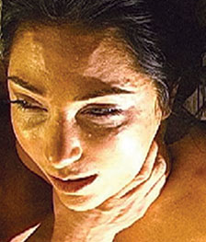
ETIOLOGY OF ASPHYXIA
Physical causes
Inhaling irrespirable gases
Drugs/poisons
Mechanical asphyxia
Pathological asphyxia
Allergic reactions

Slide 5
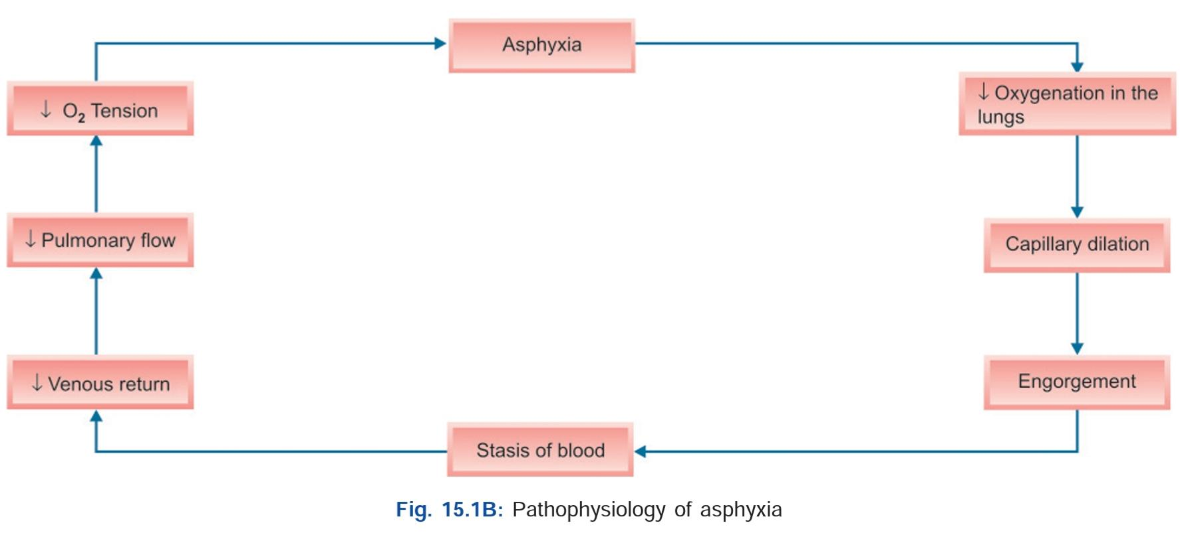
PATHOPHYSIOLOGY OF ASPHYXIA

Slide 6
ANOXIA
Gordon’s Classification of Anoxia
Anoxic Anoxia: Here oxygen cannot gain entry into the blood, e.g. hanging with obstruction of trachea—here no oxygen enters the pulmonary circulation, hence, there is no oxygen in the blood.
Anemic Anoxia: Here oxygen can get into blood, but the blood is incapable of carrying it, e.g. carbon monoxide poisoning, wherein the carboxyhemoglobin formed prevents blood oxygenation.
Stagnant Anoxia: Here oxygen can get into the blood, blood is capable of carrying it, but circulation is at failure, e.g. congestive cardiac failure.
Histotoxic Anoxia: Here oxygen can get into the blood, blood is capable of carrying it, and the blood circulation is perfectly normal, but the cell cannot utilize the oxygen available in blood, e.g. cyanide poisoning, here the cyanides destroy the cellular oxygen enzyme system cytochrome oxidases.

Slide 7
CLASSIFICATION OF MECHANICAL/ VIOLENT ASPHYXIA
1. Compression/ constriction of the neck, e.g. hanging, strangulation, throttling, etc.
2. Blocking external orifices of respiration, i.e. mouth and/or nostrils, e.g. smothering, overlying, suffocation, gagging, etc.
3. Impaction of foreign bodies in respiratory tract, e.g. choking
4. Compression and mechanical fixation of the chest and abdomen preventing the respiratory movements, e.g. traumatic asphyxia/crush asphyxia.
5. Inhalation of fluid into the respiratory tract, e.g. drowning.

Slide 8
HANGING
As complete or partial suspension of the body by a ligature tied around the neck and force of constriction on the neck being applied by the weight of the body hanged.
In hanging, death is usually due to asphyxia or cerebral anoxia or vagal inhibition leading to cardiac arrest or injury to the spinal cord as observed in judicial hanging wherein death is due to fracture-dislocation of the C2C3C4 vertebrae.

Slide 9
Classification of Hanging
Complete hanging—both feet are not touching the ground
Partial hanging—both feet or any other parts of the body are touching the ground. Thus, it may be also induced in sitting, stooping, kneeling, lying prone or supine positions.
Typical hanging—knot of ligature is on the backside of the neck
Atypical hanging—knot of the ligature is anywhere other than on the backside of the neck. Usually location for the knot is near the mastoid process or angle of mandible. Occasionally, it may be under the chin

Slide 10
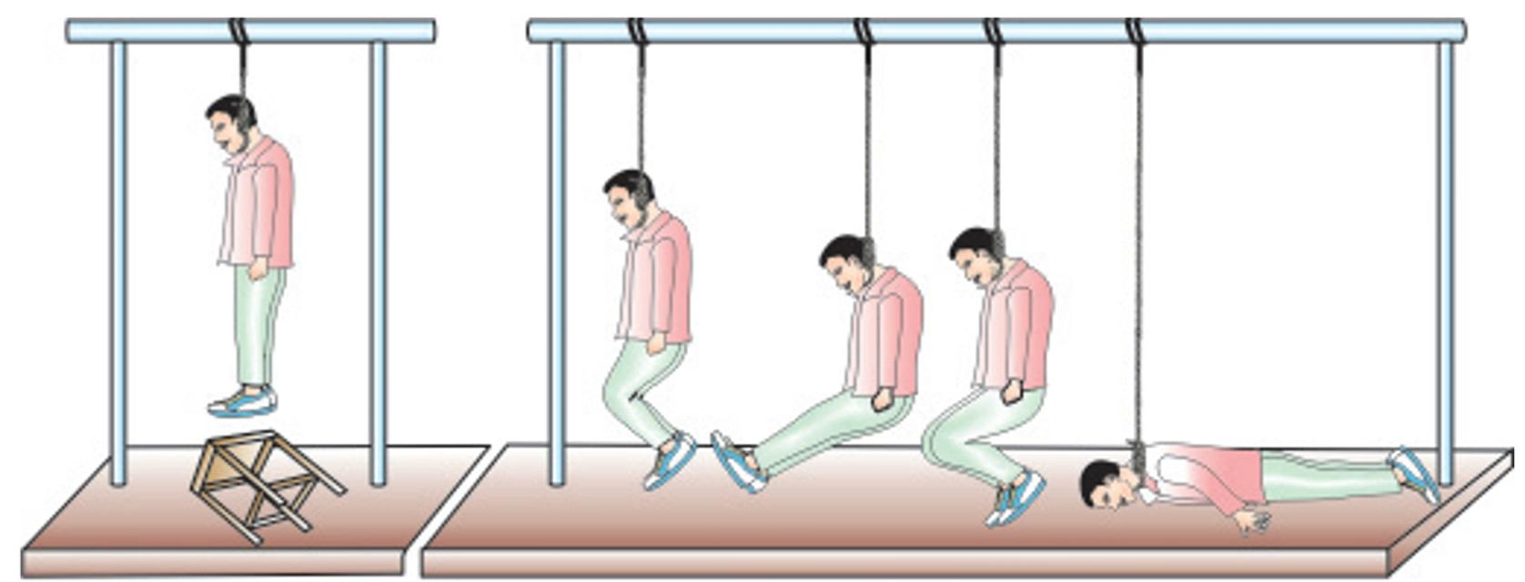

Slide 11
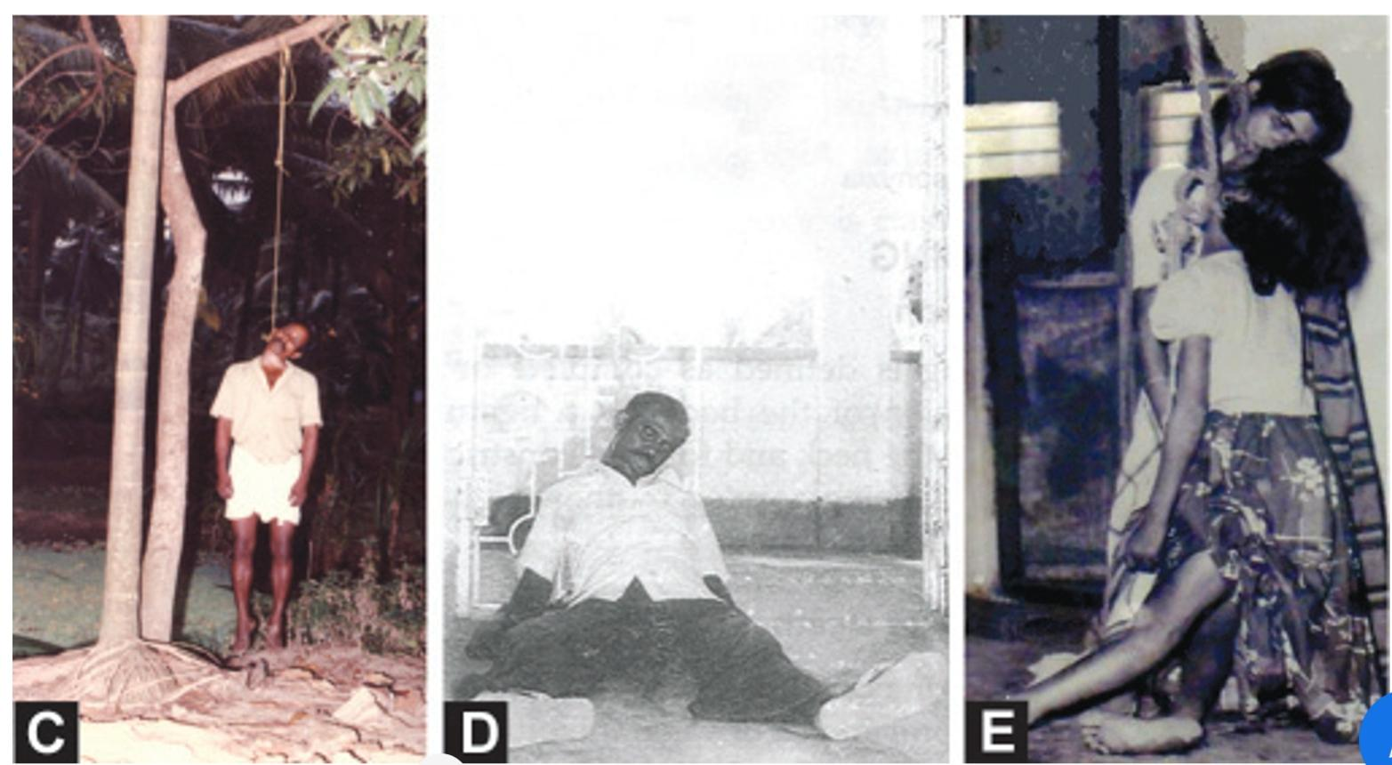

Slide 12
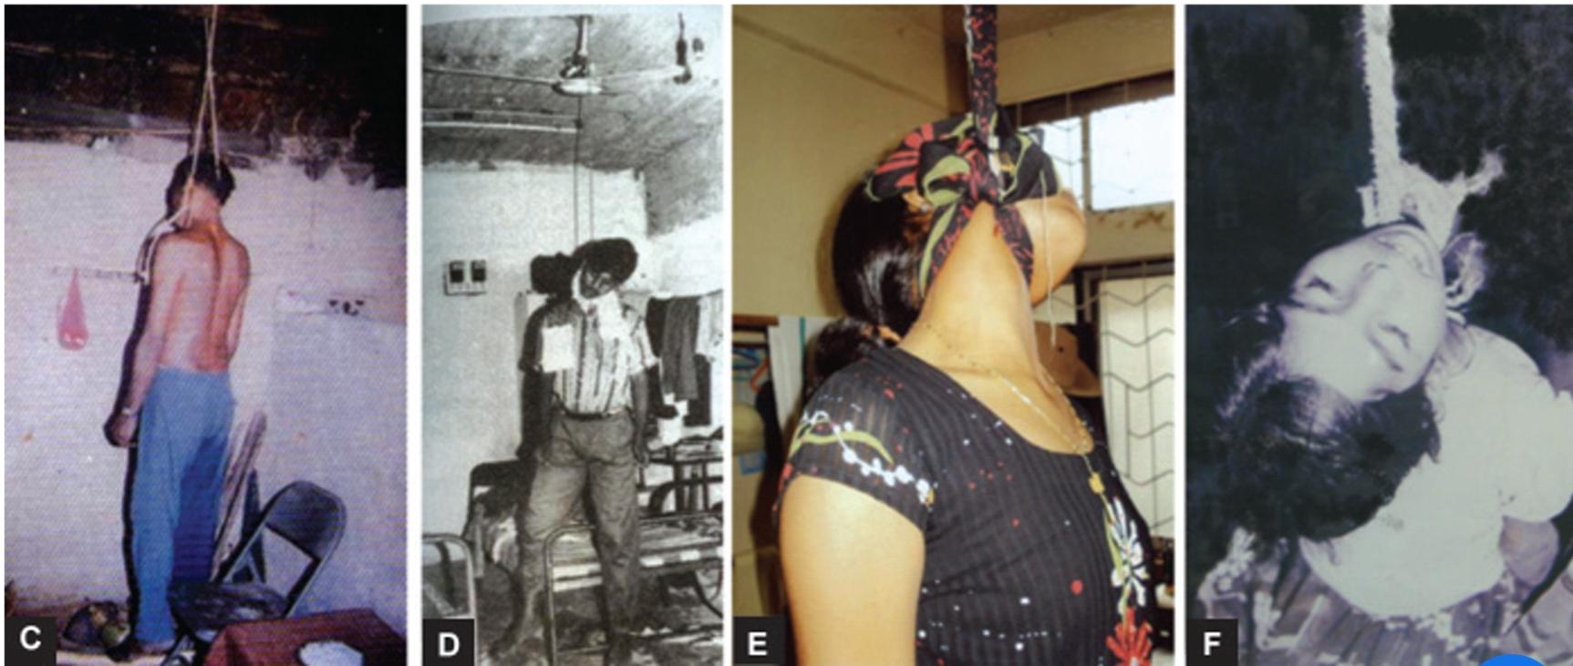

Slide 13
Mechanism of Hanging It has been scientifically accepted that pressure on the neck can result in occlusion of neck structures for respiratory functioning,developing asphyxia. Experimentally, it has been proven that pressure/force of 2 kg (4.4 lbs) and 4-5 kg (8.8-11 lbs) on the neck can occlude jugular vein and carotid arteries respectively, 15 kg (33 lbs) can occlude trachea and 30 kg (66 lbs) can occlude vertebral arteries.4,8 All these can bring about gross decrease in cerebral blood flow leading to cerebral anoxia, asphyxia and death.

Slide 14
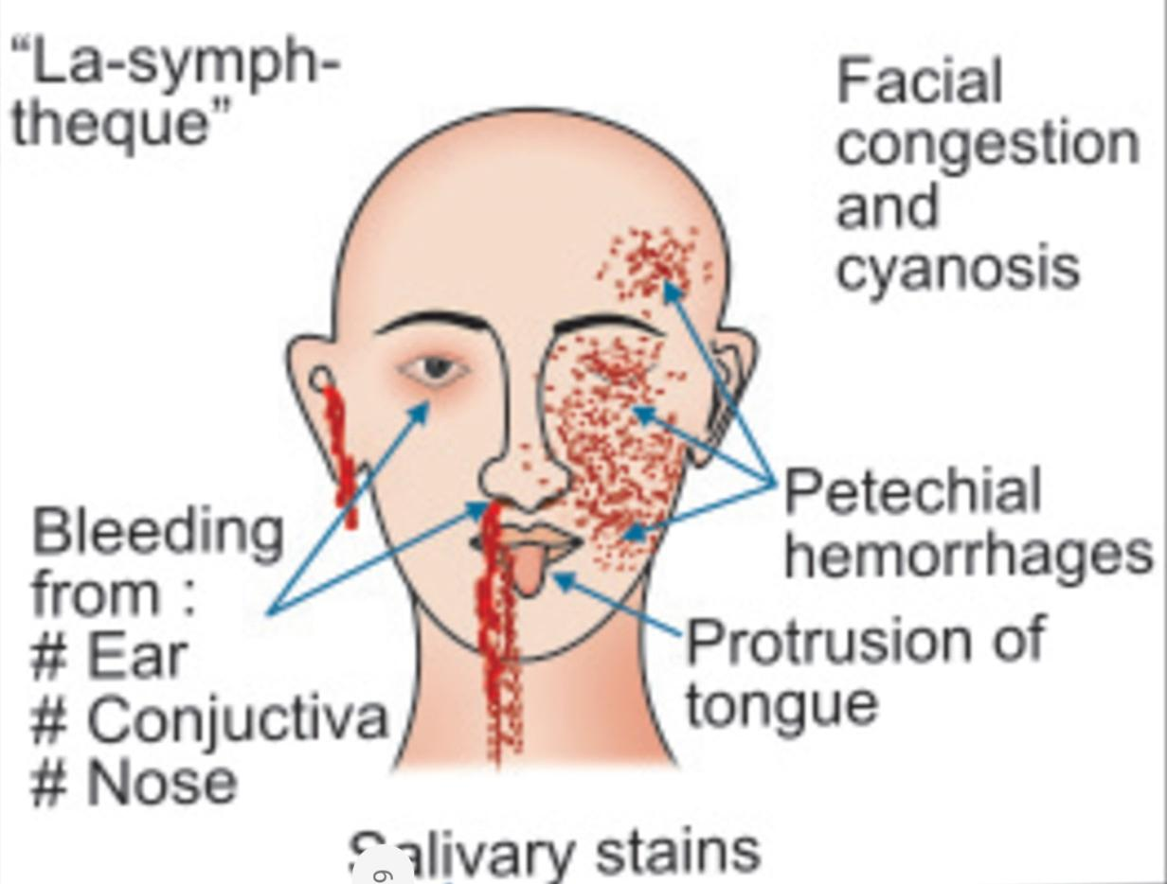
AUTOPSY FINDINGS
EXTERNAL
Findings in the face Changes in the eyes – Eyes may show following findings:–Prominent eyeballs – Eyeballs may look prominent due to increased pressure as a consequence of impaired circulation and venous return resulting in passive accumulation of blood
La-facie sympathique – Etienne Martin (1950) described this peculiar change wherein right eye remaining open with dilated pupil and the left eye closed with small pupil.

Slide 15
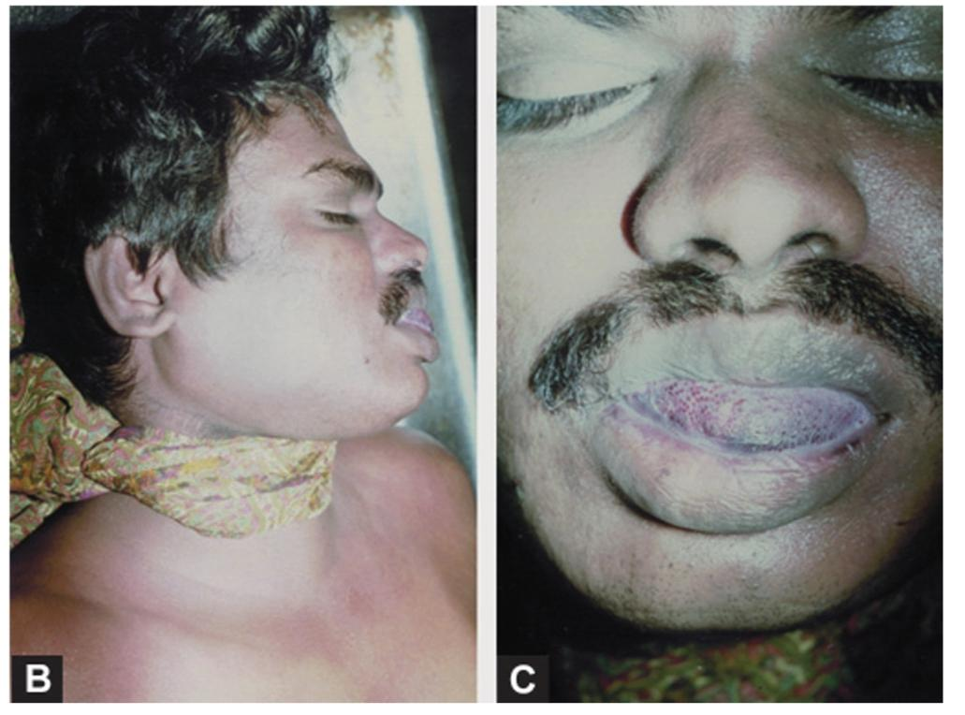

Slide 16
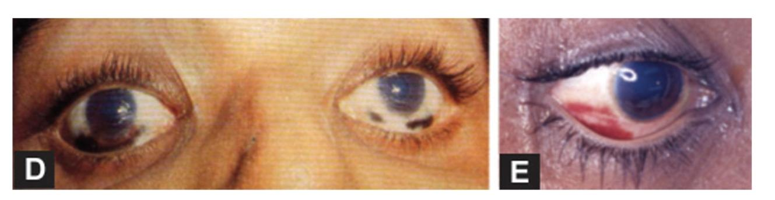
Bleeding from nose/ears – Due to the impaired venous return and increase in pressure within, resulting in rupture of vessels and passive flow of the blood from nostrils and ears.

Slide 17
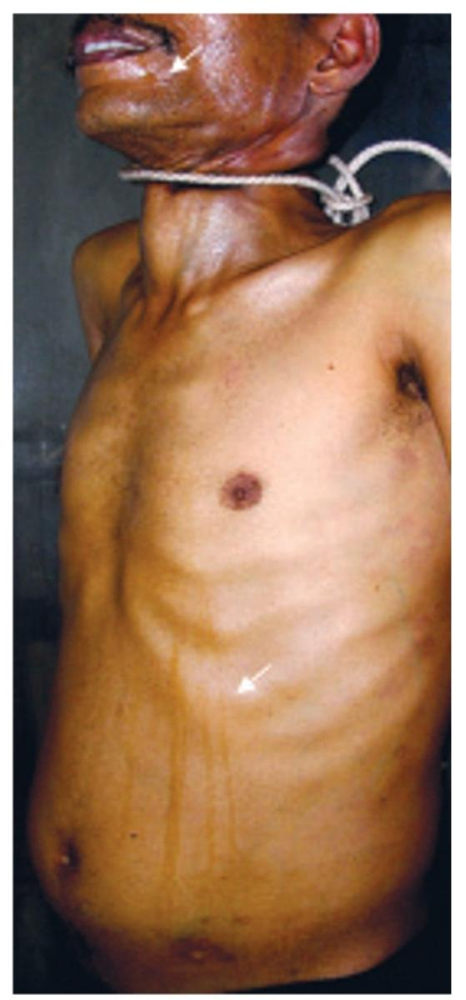
Salivary dribbling marks – It is a constant and important finding in case of death due to hanging. Normally salivary secretion is a constant phenomenon in life, however, it is being swallowed continuously. When death takes place the deglutition also stops, while the local pressure and irritation exerted by the ligature on submandibular salivary glands continues and this results in secretion of saliva. This can flow passively through the lower angle or dependent parts of the mouth, and is suggestive of antemortem hanging

Slide 18
Findings in the Neck
Distended neck veins – Prominently distended neck veins, above the ligature.
Ligature mark of hanging

Slide 19
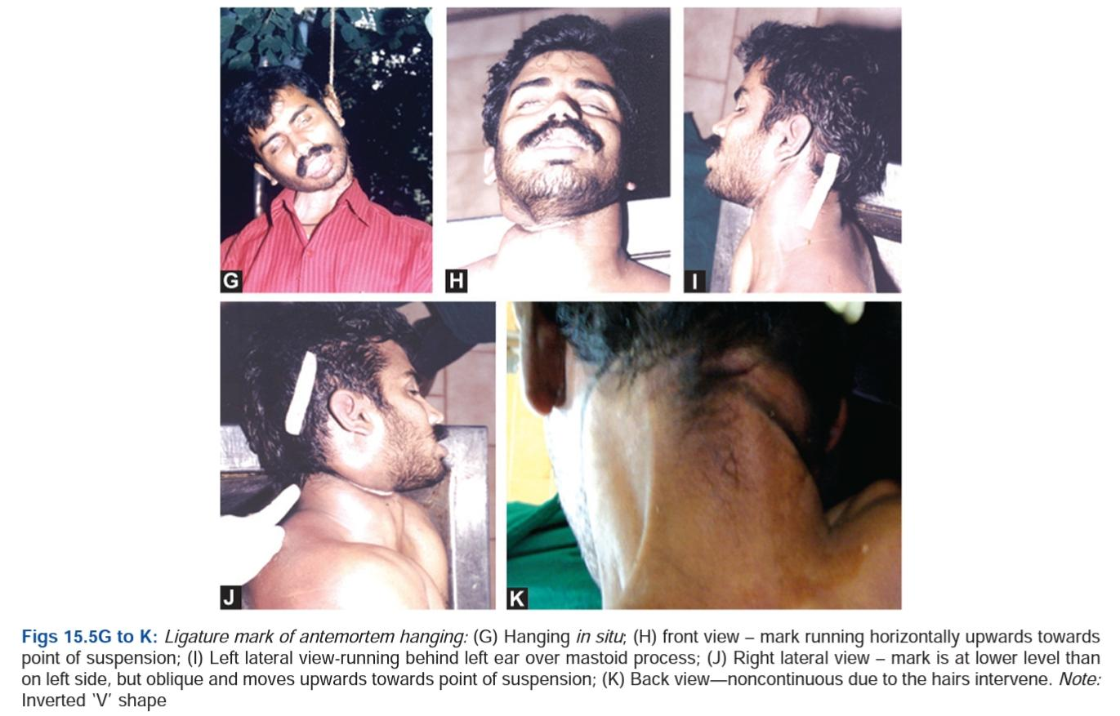
Ligature mark of hanging

Slide 20
• Site – seen round the neck; usually situated above the thyroid cartilage (Adam’s apple) in about 75 per cent of cases of hanging, at the level of thyroid cartilage in another 15 per cent and below the thyroid cartilage in remaining 10 per cent cases.
• Size/shape – depends on the type of material used.
• Cause – weight of the body tightening the ligature material around the neck.
• Appearance – A typical ligature mark is usually seen in antemortem hanging. It is also reported to appear if hanged immediately after death or within a period of 2 hours of death (vide infra). However, ligature mark produced so will not be as prominent as in antemortem hanging.

Slide 21
Findings in Other Parts of the Body
Hands – Hands are usually clenched. May be at times the hands may show the jute fibres, such as that of jute fibre when jute rope is used as the ligature material. Hands may also show bluish discolouration of fingertips and nail beds due to cyanosis.
Postmortem hypostasis – Purple coloured postmortem hypostasis is usually in a peculiar distribution in the lower limbs and lower regions of upper limbs (hands/forearm).
Involuntary voiding of urine and /fecal matter– stains of which may be seen on the under garments/on the floor below.

Slide 22
Abrasions or contusions on lateral aspect of shoulder, feet, toes – Abrasions or contusions on lateral aspect of shoulder, feet, toes, etc due to friction with a wall or a pillar during suspension, in the last phase of life when there are convulsions. Injuring parts of the feet or toes may also be noticed, is again common while making an attempt to jump from a support such as a wooden stool or a steel chair or a tree branch at a height, or such other things in the process of inducing suicidal hanging.

Slide 23
In male victims
Penile turgidity—penis may be found turgid and erect.
Seminal voiding—seminal emission may be noticed at the tip of the glans penis over the thighs or seminal stains may be seen on inner garments, etc. It may also be seen on the floor immediately below the site of hanging. This is explained to be due to sphincter relaxation due to asphyxia of higher centres of the brain controlling these muscles.
Voiding of urine and stools – may also be seen due to relaxation of the sphincters.

Slide 24
In female victims: Apart from the voiding of urine and stools, turgescence of vagina with blood-stained discharge may also be noticed.

Slide 25
INTERNAL
Findings in the lungs – Lungs will be congested, distended and emphysematous with plenty of hemorrhagic spots (Tardieu’s spots) subpleurally. Cut section usually exudes frothy fluid blood, if constriction occurs at the end of exspiration. It would be pale with little or no congetion, if constriction occurs at the end of inspiration.
Findings in the heart – Heart is congested and shows Tardieu’s haemorrhagic spots over the pericardium.
Findings in the brain – Brain and its membrane will be congested and with or without scattered petechiae on its surface and substance.
Findings in abdominal viscera – All the abdominal viscera are congested.
Blood changes – Blood will be fluid and purplish in colour.

Slide 26
Neck findings
In every case of death by hanging, a careful dissection of the neck is done, layer by layer, so as to not to miss any of the internal findings, confirming hanging as the cause of death.
Bloodless Dissection of Neck This simply means conducting the neck dissection at the end of autopsy examination, after performing dissection of cranium above and thorax and abdomen below, with removal of every other viscera except in the neck. Majority of cases according to the author’s experience, show no internal injuries in the neck. DiMaio reports of only 50 per cent of cases presenting with internal neck injuries in hanging victims.

Slide 27
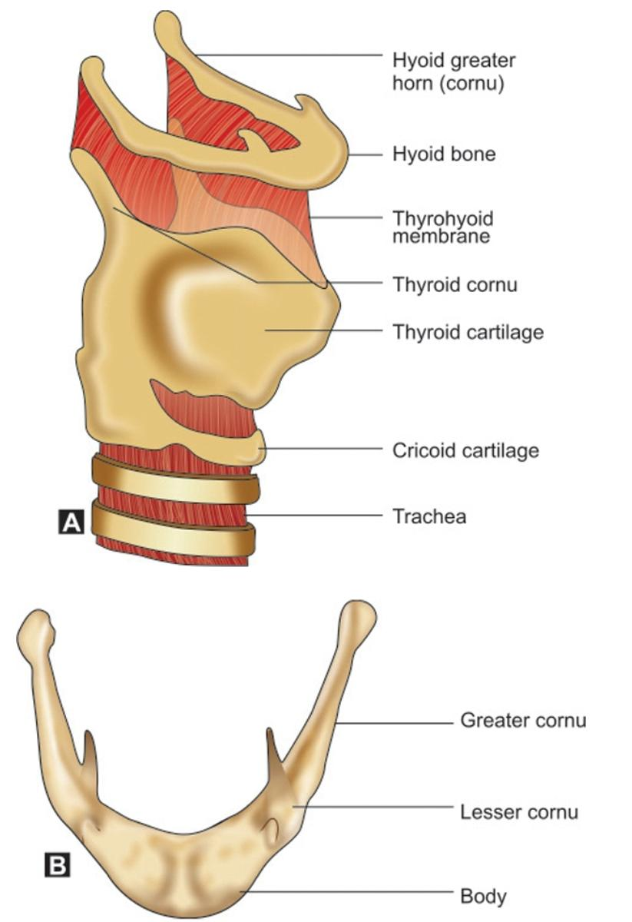
Forensic Anatomy of Hyoid Bone and Larynx

Slide 28
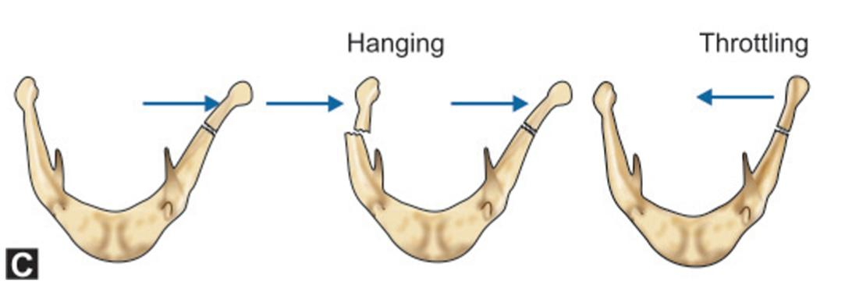

Slide 29
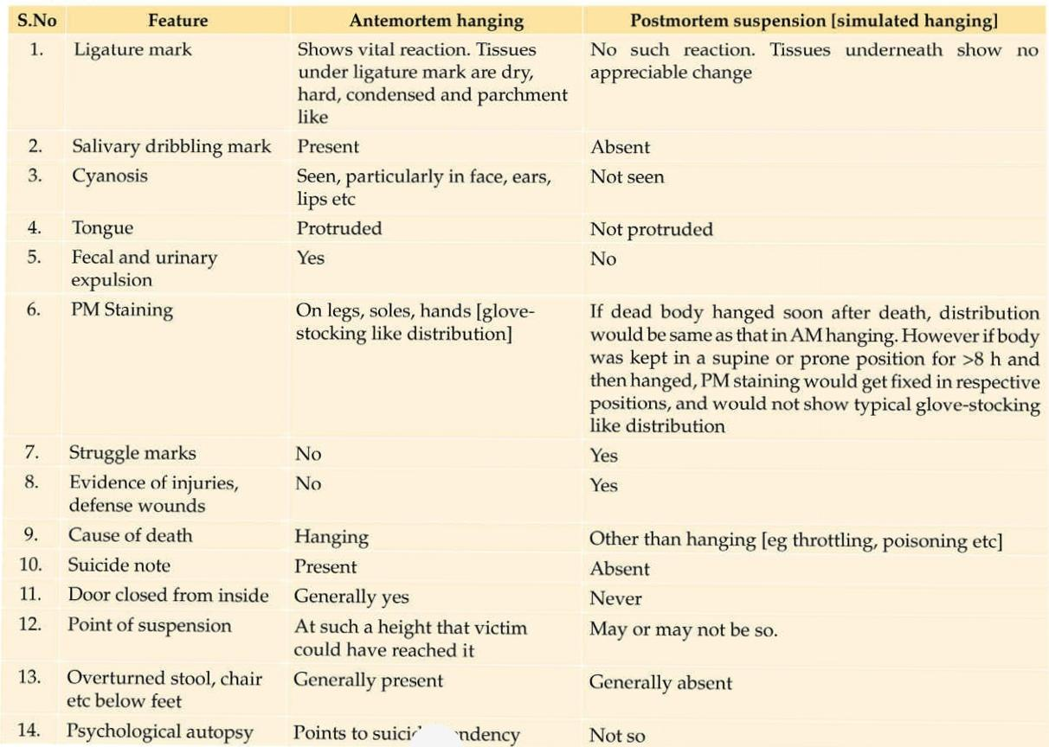

Slide 30
Accidental Hanging
Among infants—e.g. umbilical cord around the neck – thisis also known as twisting of cord around the neck. This cancause the death of the fetus during birth or occasionally,immediately after birth from asphyxia due to accidentalstrangulation
Among adolescent/adults—e.g. Sexual asphyxia,popularly known also as “sex associated asphyxia, autoerotichanging, asphyxiophilia, hypoxiphilia, Kotzwainism,masochistic phenomenon”,
Among children—e.g. while playing Lasso. Here the neckof the child may get entangled in a ropes resulting in deathdue to asphyxia.

Slide 31

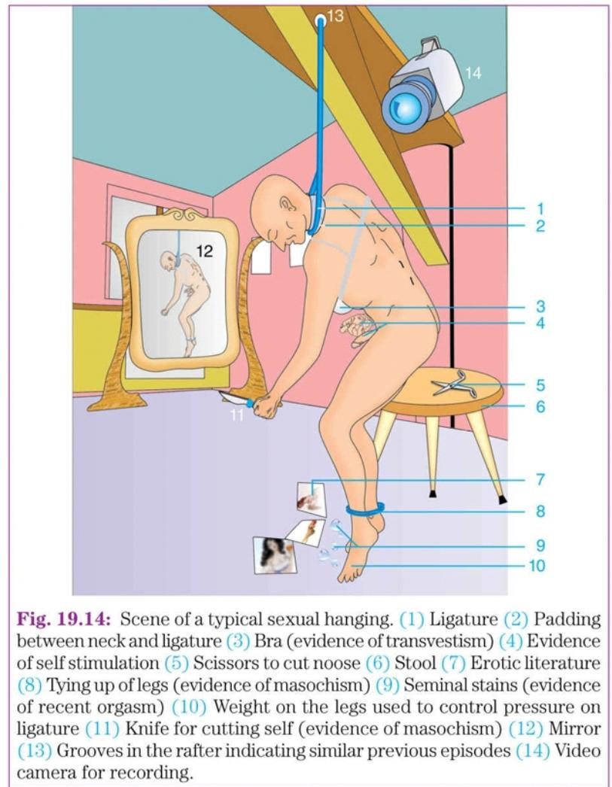

Slide 32
Judicial Hanging
Cause of death in judicial hanging is due to injury to spinal cord in the neck because of the fracture and dislocation of upper cervical vertebra C1,2 or 3 and contusion or transaction of the underlying cord.

Slide 33
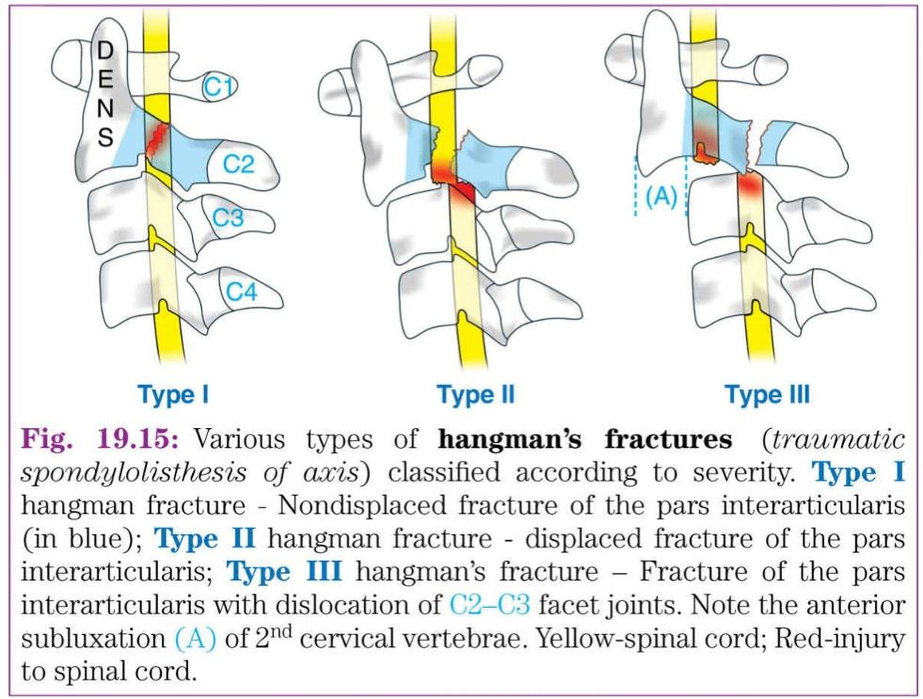

Slide 34
Lynching
Lynching is hanging of a victim who may be criminal by a mob. Thus it is homicidal hanging. The people who get angry by the offence committed by the accused, kill him publicly by hanging to demonstrate the punishment given to him.

